Slide 1

Ideal gas law and molar volume of gases

Slide 2
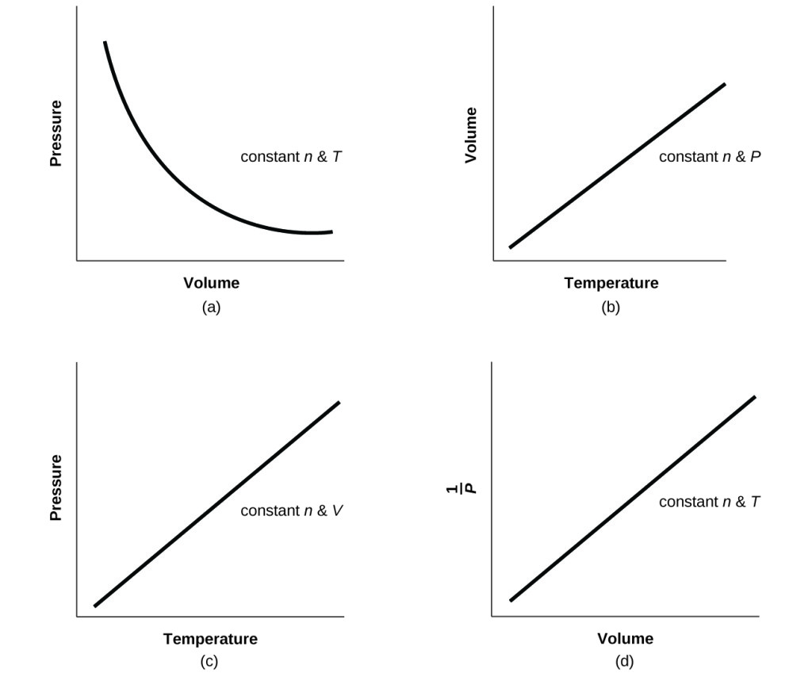

In summary
Pressure inversely proportional to volume (n, T constant)
Volume is directly proportional to temperature (n, P constant)
Pressure directly proportional to temperature (n, V constant)
If we plot 1/P vs V we get a linear relations NOTE – this is still inversely proportional

Slide 3
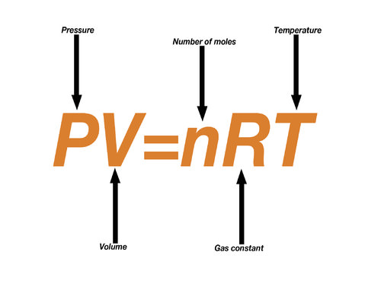
Videos
https://www.youtube.com/watch?v=o3f_VJ87Df0
https://www.youtube.com/watch?v=robEY-idcLU
Ideal gas law – we will be learning to use this relationship tomorrow.

Slide 4
Ideal Gas Law
Measurable properties of a gas:
Amount of gas - moles - symbol is n
Pressure - symbol is P
Volume - symbol is V
Temperature - symbol is T

Slide 5
Recall
Boyle’s Law | Charles’ Law | Avogadro’s Law
V ∝ 1/P | V ∝ T (Kelvin) | V ∝ n
Constant T, n | Constant P, n | Constant T, P
So V ∝ 1/P X n X T

Slide 6
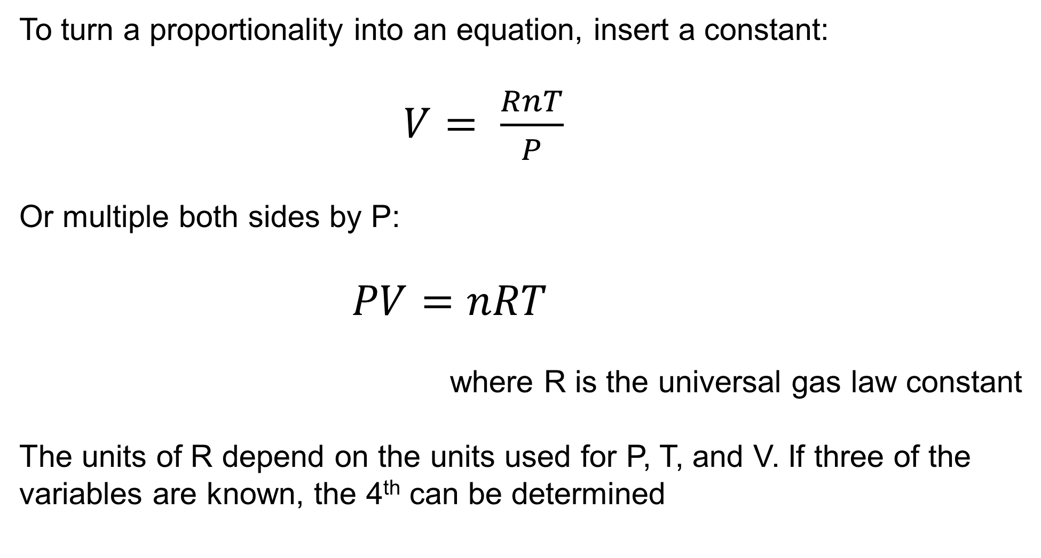
Ideal Gas Law
To turn a proportionality into an equation, insert a constant:
$V= \frac{RnT}{P}$
Or multiple both sides by P:
$PV=nRT$
where R is the universal gas law constant
The units of R depend on the units used for P, T, and V. If three of the variables are known, the 4th can be determined

Slide 7
Units of R
Two common values of R:
0.08206 Liter⋅Atm
8.314 Joules or 8.314 Liter⋅KPa
Mole⋅K
Mole ⋅K
Mole⋅K
Your data sheet uses: 8.314 J K⁻¹ mol⁻¹

Slide 8

Ideal Gas Law
Units of measurement for gas properties:
Amount of gas - moles
$$n= \frac{m}{M}$$
Pressure - 1 atm = 100 kPa
Volume – Litres (L) ext. 1 mL = 1 cm³
Temperature – Kelvin (K)
T(K) = T(°C) + 273.15

Slide 9
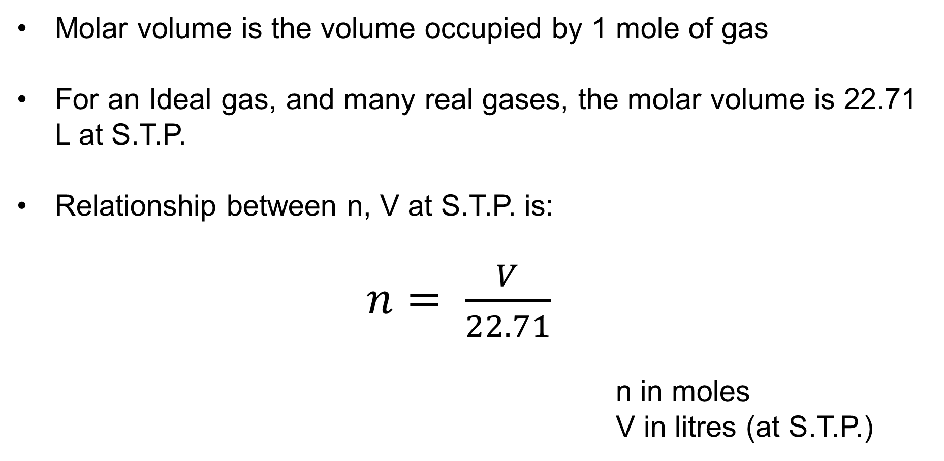
Molar Volume of Gases
Molar volume is the volume occupied by 1 mole of gas
For an Ideal gas, and many real gases, the molar volume is 22.71 L at S.T.P.
Relationship between n, V at S.T.P. is:
$n= \frac{V}{22.71}$
n in moles
V in litres (at S.T.P.)

Slide 10
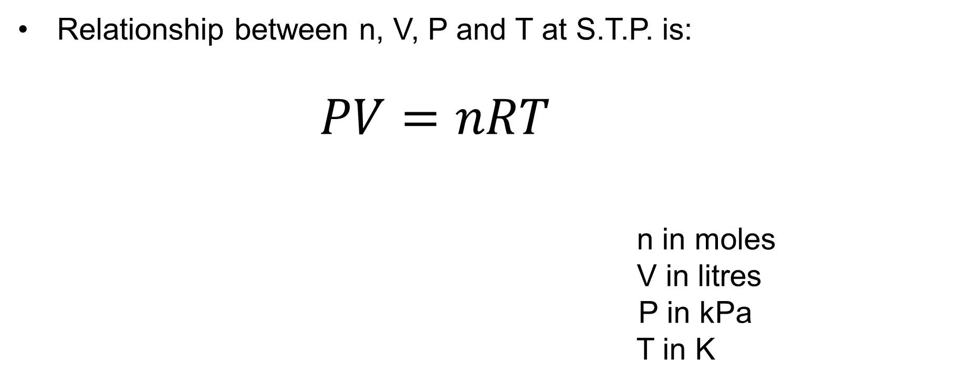
Ideal Gas Equation
Relationship between n, V, P and T at S.T.P. is:
$PV=nRT$
n in moles
V in litres
P in kPa
T in K
R = 8.314 J K⁻¹ mol⁻¹

Slide 11
Ideal Gases
An “ideal” gas exhibits certain theoretical properties. Specifically, an ideal gas …
Obeys all of the gas laws under all conditions.
Does not condense into a liquid when cooled.
Shows perfectly straight lines when its V and T & P and T relationships are plotted on a graph.
In reality, there are no gases that fit this definition perfectly. We assume that gases are ideal to simplify our calculations.

Slide 12
Sample problems
How many moles of H₂ is in a 3.1 L sample of H₂ measured at 300 kPa and 20°C?
PV = nRT
P = 300 kPa, V = 3.1 L, T = 293 K
(300 kPa)(3.1 L) = n (8.31 kPa•L/K•mol)(293 K)
(300 kPa)(3.1 L)
= n = 0.38 mol
(8.31 kPa•L/K•mol)(293 K)

